Slide 1
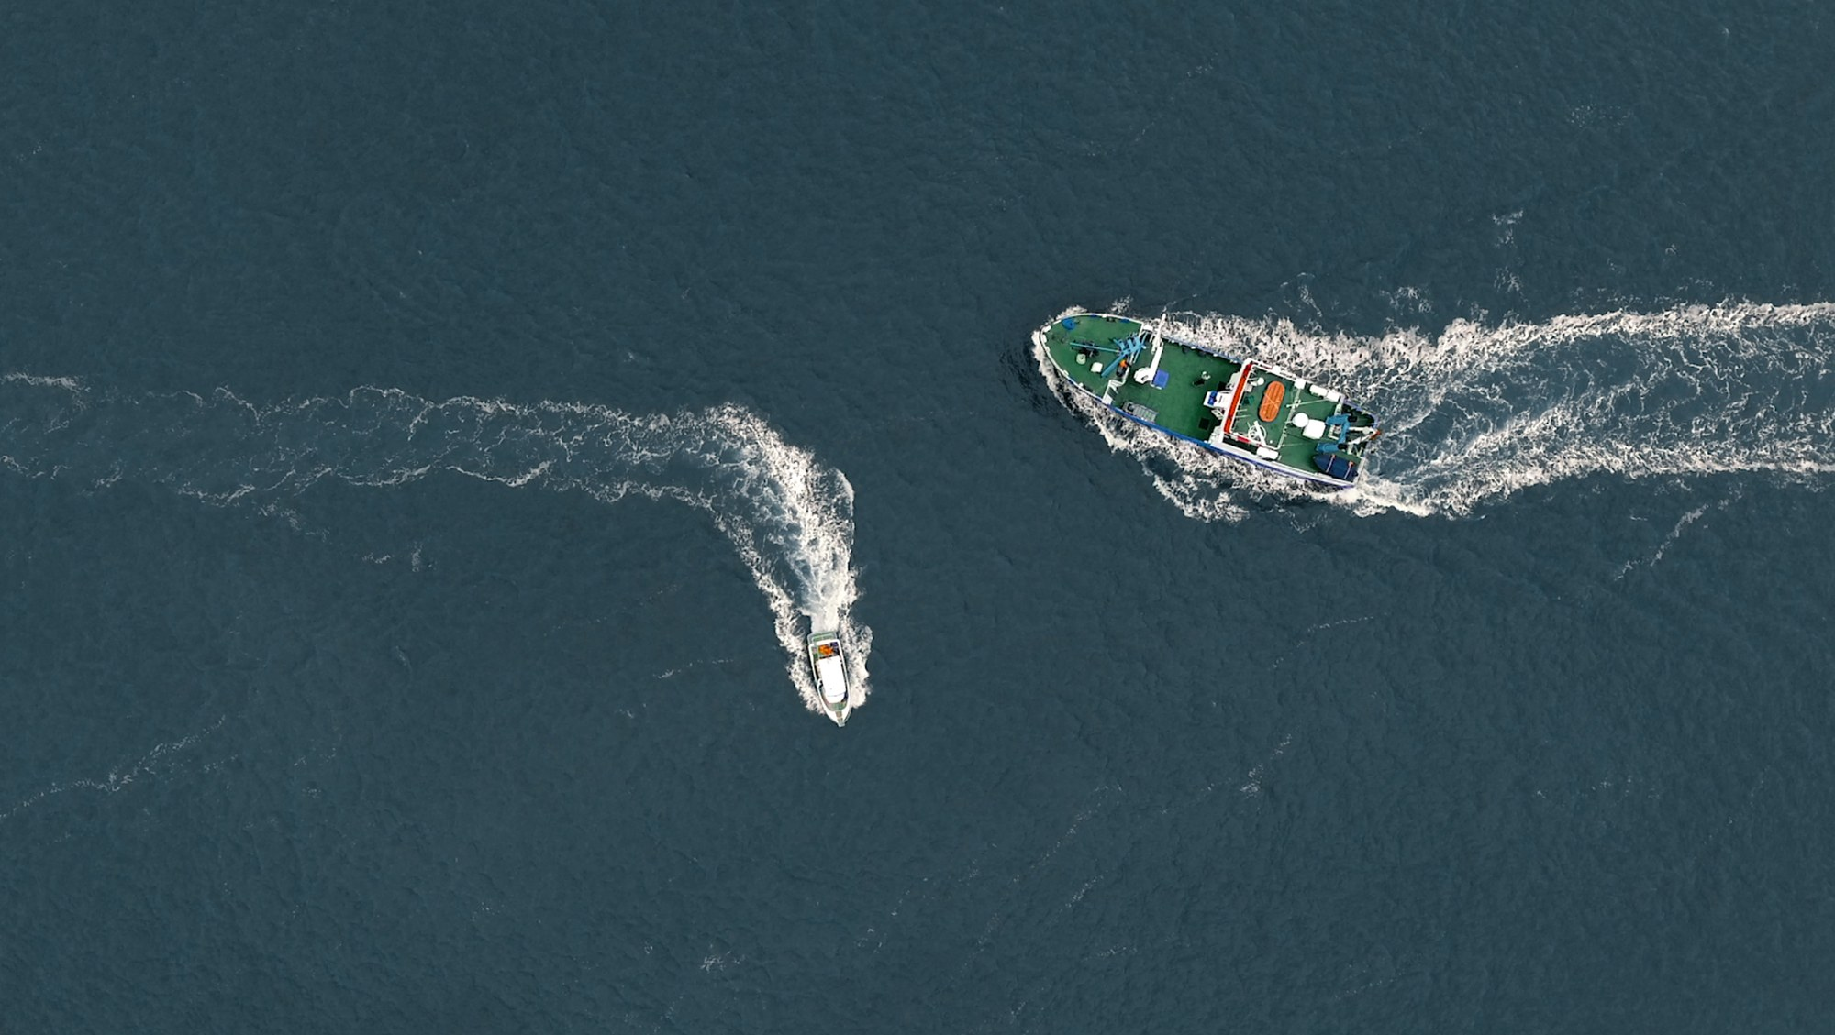
From Training to Practice: A shift to Just in Time User Support
July 2025
Andy Nicholls, Senior Director, Head of Data Science Innovation and Engineering
https://www.dlr.de/en/research-and-transfer/featured-topics/maritime-research/collision-avoidance-for-highly-automated-ships
Notes:
Nautical theme
Presenting GSK’s story: where we went after training everyone.

Slide 2

Making Commitments, August 2023
Biostatistics’ commitments to open source
All central tools to be built using open-source languages
50% of our code to be open-source by end 2025
Image source: https://how-to-propose.com/en/column/article_4206/
Notes:
Set the scene
1st change: over night
2nd = ending this year, on target

Slide 3

Making waves
Notes:
Inspiration for nautical theme is that we can break down our user-focussed adoption approach into distinct waves

Slide 4





GSK’s Open-source Journey
Adoption Waves
Wave 0
Wave 1
Wave 2
Wave 3
R Platform V1.0
?
R4GxP
80% staff trained in Tidyverse
AccelerateR
Period of the ad-hoc R course
First pilot study QC in R
Full pilot study in R
Supporting tools
…and again
…and again
2017
2024
Notes:
Presented in Posit webinar w/ Ben/Becca
Focus here is on training / user support *but* in change management *all* needs to align
Wave 0: Ad-hoc
Wave 1: Everyone does
Wave 2: Focus on what we did
Wave 3 = surprise for you

Slide 5
Wave 1: Mass Training
Notes:
Start where everyone starts with mass training

Slide 6
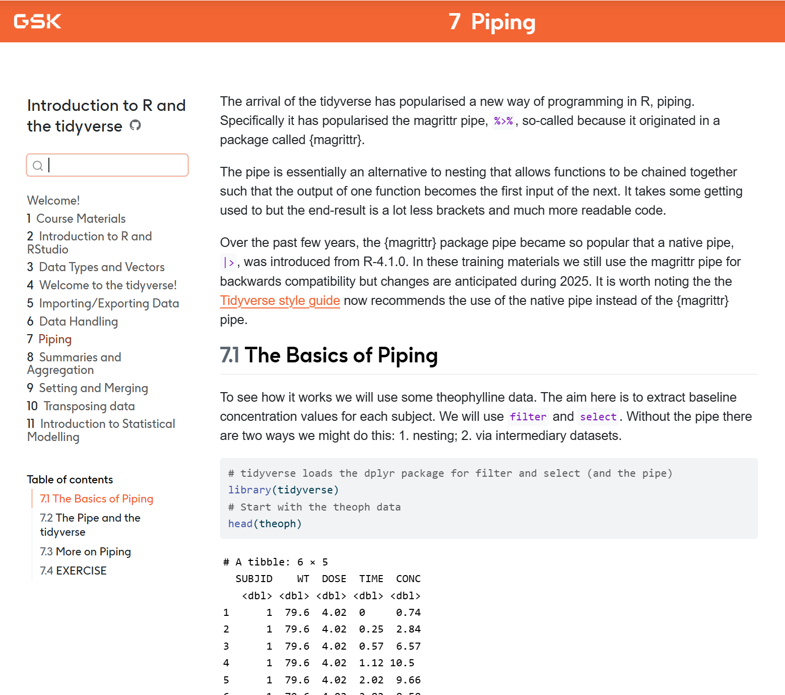
Objective: 80% Coverage of Workforce
Core courses:
Introduction to R and the Tidyverse
Graphics with ggplot2
Mostly F2F, moving to virtual
Course written in bookdown (now quarto) to double-up as written reference
No slides!
Successfully hit 80% course completion target
Notes:
Usual, with a tidyverse focus
F2F but we wrote markdown/quarto which helped later when virtual

Slide 7

“Can we have some advanced training please?”
Notes:
Whether people like the training or they want an excuse not to learn R, they want more
Could go into detail as to whether that’s right. Generally we felt no.
Open-source way is much more about self-serve

Slide 8
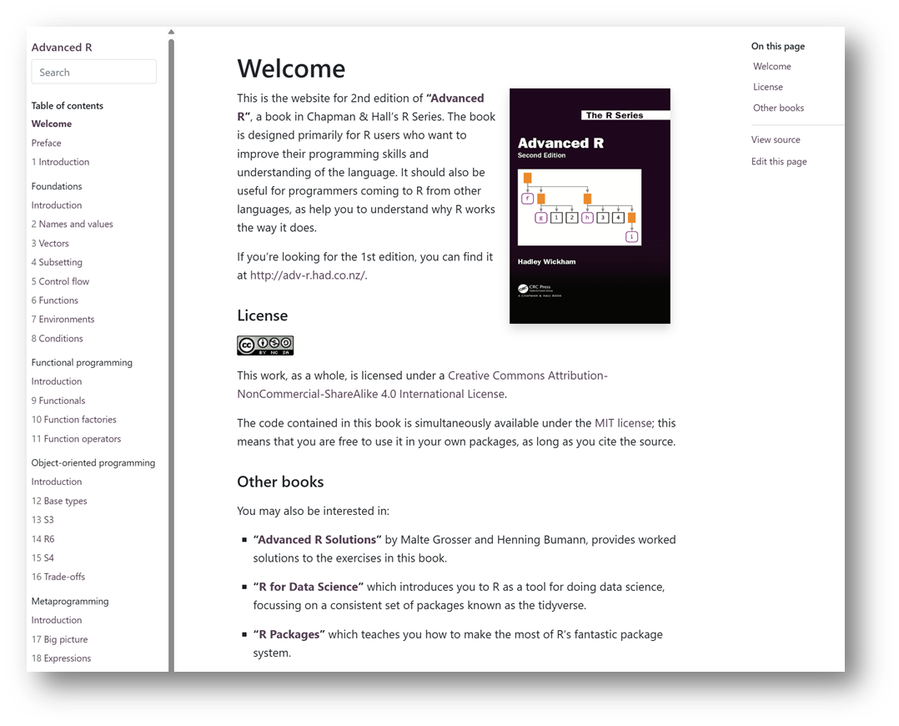
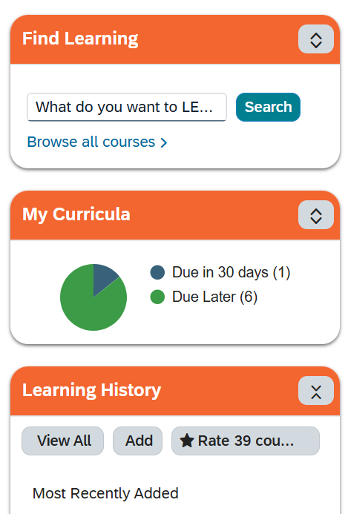
“Can we have some advanced training please?”
Change
Challenge
Notes:
The problem with ‘advanced training’ is it means something different to everyone
We told everyone to read up online, eg read Hadley’s advanced R book
But they are used to GxP training where they sign off in a system to say “I’ve done my training”
Change challenge: Need to shift the mindset to open-source
What did we do?...

Slide 9
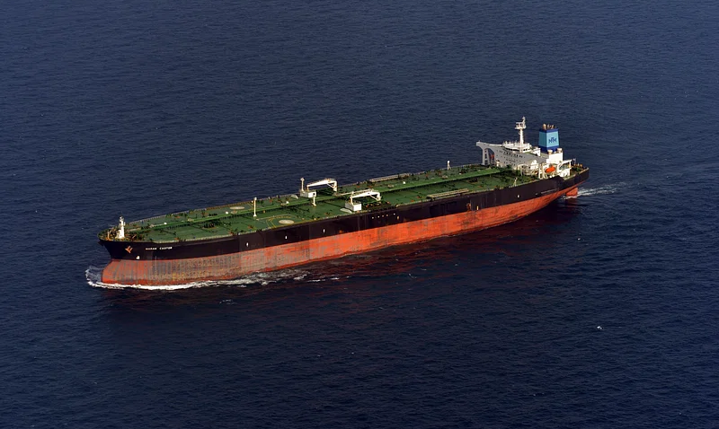
Changing Mindset
Turning the tanker around…
Conceded some ground
Created a self-certify option in our training system
Developed a new “intermediate” function-writing course
Built a resource Hub to point to useful external resources
Image source: https://www.rawpixel.com/search/oil%20tanker?page=1&path=1522&sort=curated
Notes:
Oil tankers are renowned for not changing direction easily.
People work in GxP and are used to signing off to say they’ve read the SOP
Concede water – give them a bit of what they want, stand true in some areas

Slide 10
Wave 2: Acceleration
Notes:
Training largely a success. What next?
How do we actually get people using R?

Slide 11

Supporting the Early Adopters
Notes:
Need their enthusiasm
Need them to set the example
How did we engage?

Slide 12
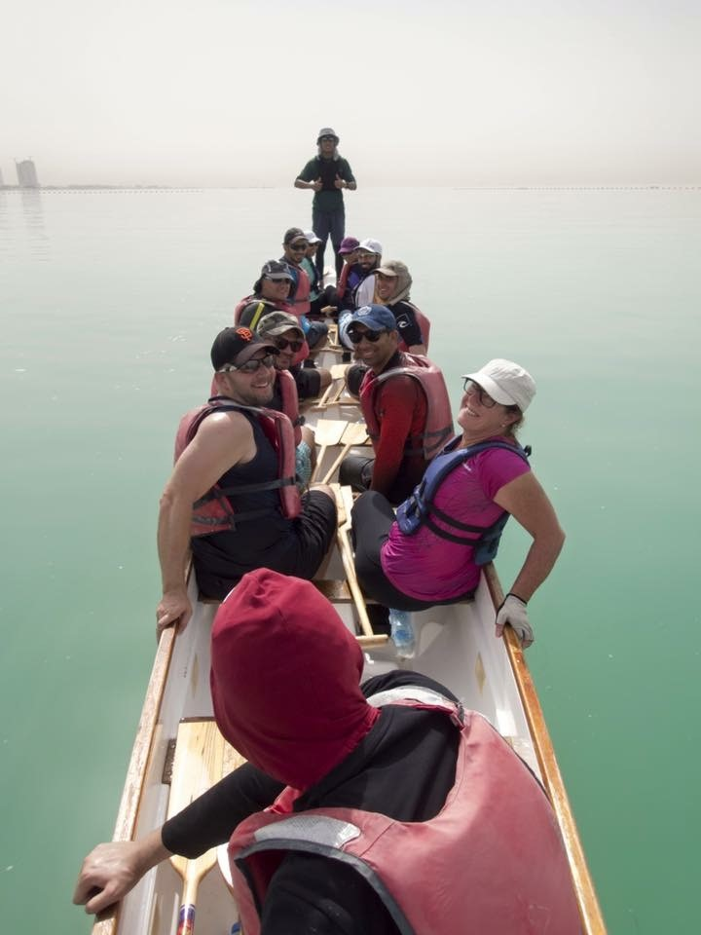

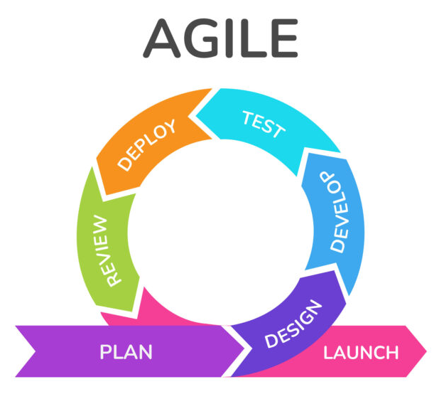

“AccelerateR”
Side by side support
Pre-requisites
Ensure common baseline
On Boarding
Identify (+ fill) knowledge gaps
Deliver
Challenges guided by the team
Answer questions, review code
Close Out
Share templates for other teams
Image source: https://wwhidoha.com/dragon-boating-part-worlds-fastest-growing-water-sport-right-qatar/
Notes:
Labour intensive approach. Work side by side with a few early adopters and make their journey a positive one!
…
Review code because you don’t learn good practice from training.
And we wanted to share templates for others

Slide 13
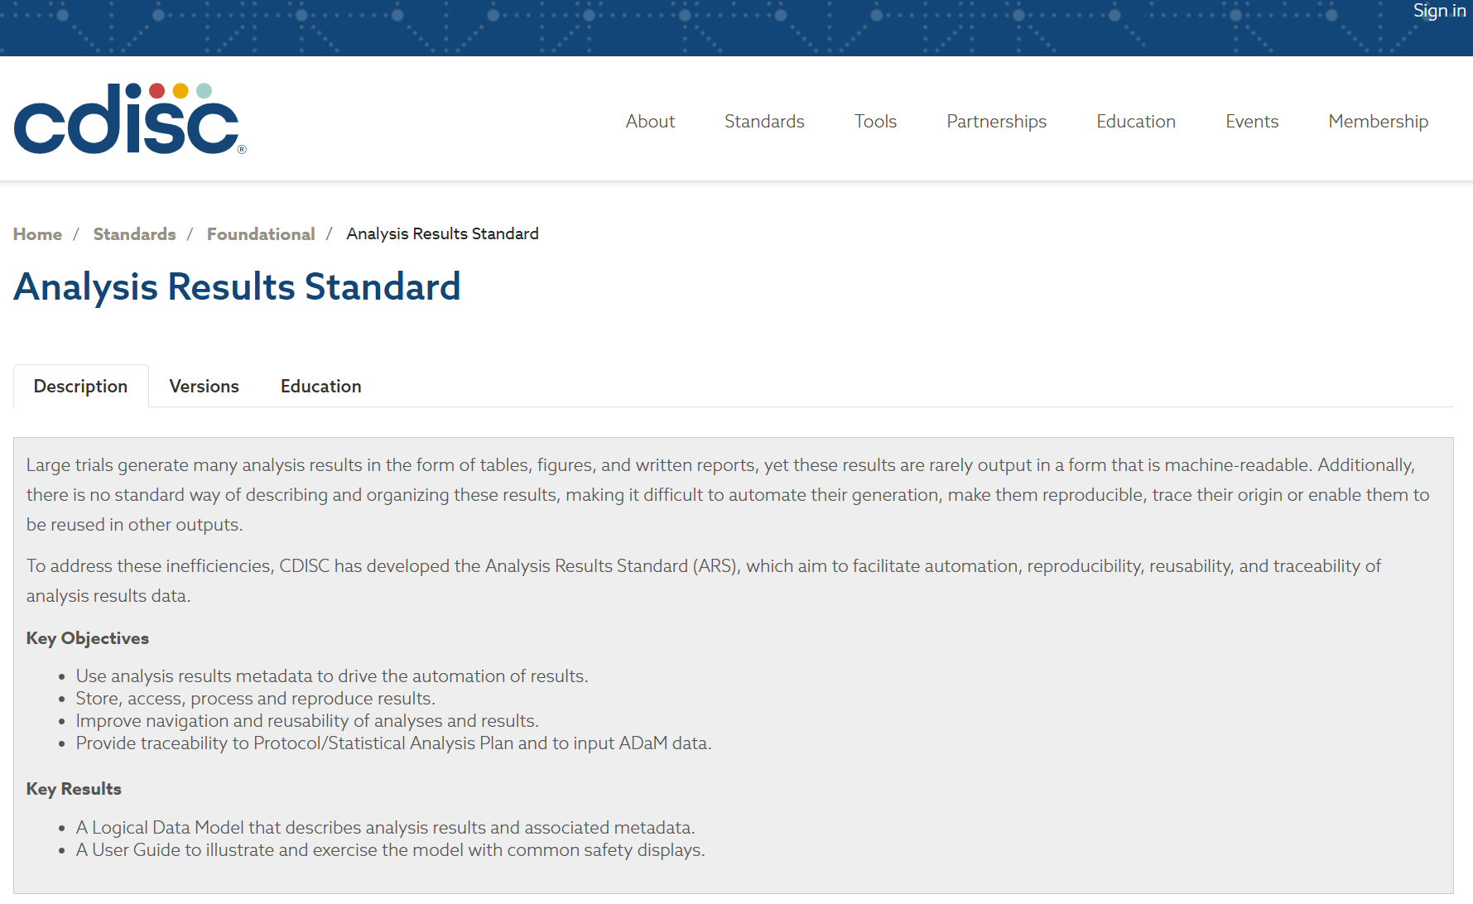

Everything changes. Always.
Don’t be too ambitious!
Image source: https://www.modernsailing.com/article/inside-the-sailing-gear-bag

Slide 14
Everything changes. Always.
Don’t be too ambitious!
Image source: https://www.modernsailing.com/article/inside-the-sailing-gear-bag
Notes:
There are always other things
In our case, move to R was an opportunity to improve reporting tools – separate actual analysis from formatting of results
GitHub part of the mindset, agile we could drop

Slide 15

AccelerateR Adjusting course
Image source: https://www.lifeofsailing.com/blogs/articles/what-is-ship-wheel-called
Notes:
Started out with teams hsowing them how, but realised tat sometimes it was not going to be possible without building more tools / changing our processes

Slide 16
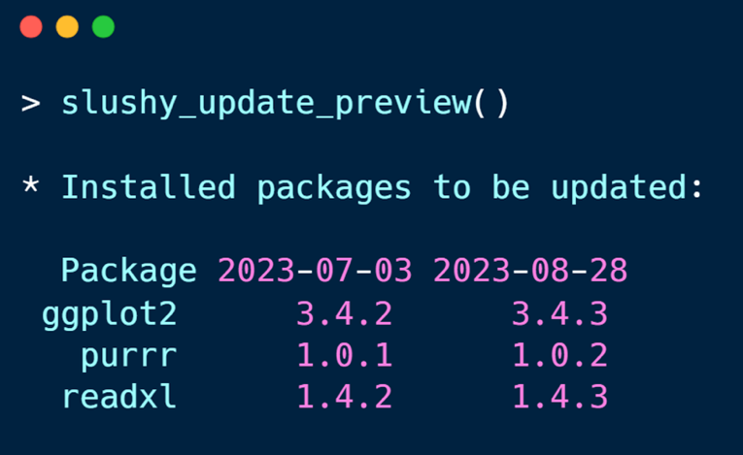









On the bleeding edge
Update
Update
Update to upcomingsnapshot
Current
Frozen Environment
Future
Frozen
Environment
Notes:
We ask teams to work in a frozen environment as a way of managing packages. Frozen = cannot install anything
We worked with an oncology team wanting to use admiral, a pharmaverse package for creating adam data
They said, ideally, we want to work with admiralonco as that has some oncology-specific functionality
This was coming in the next release but not available now.
Based on what study teams were being told at the time, this meant having to wait.
We started looking at renv but team felt it would be difficult to use. So we worked with them to pioneer a new package called slushy (designed to give flexibility in frozen environments)
This works on snapshots that they could update over time to add in new packages, eventually updating to match the next frozen environment

Slide 17
Wave 3: Mass User Support
Notes:
Mid 2024, all tools built. Could improve. Or maybe we could try something else…

Slide 18
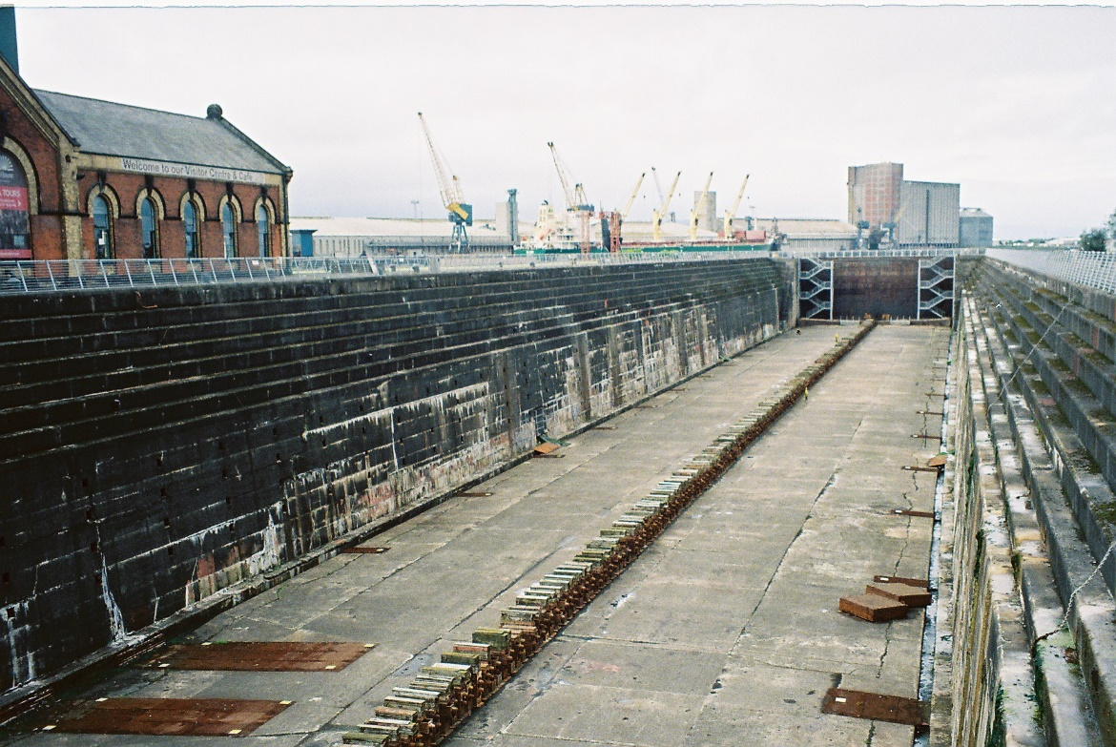

Introducing “STARburst”
Two simple changes…
1. Stop building
2. Say Yes
Image sources:
Left: https://commons.wikimedia.org/wiki/File:Titanic_Dock,_Belfast_27.6.2013_CNV00012_%2810430813006%29.jpg
Right: Image source: https://www.netflix.com/gb/title/70100379
Notes:
3 months early this year, started starburst
“burst” because it was 3 months, “STAR” because by this point we’d named our push to R in line with other space tools

Slide 19
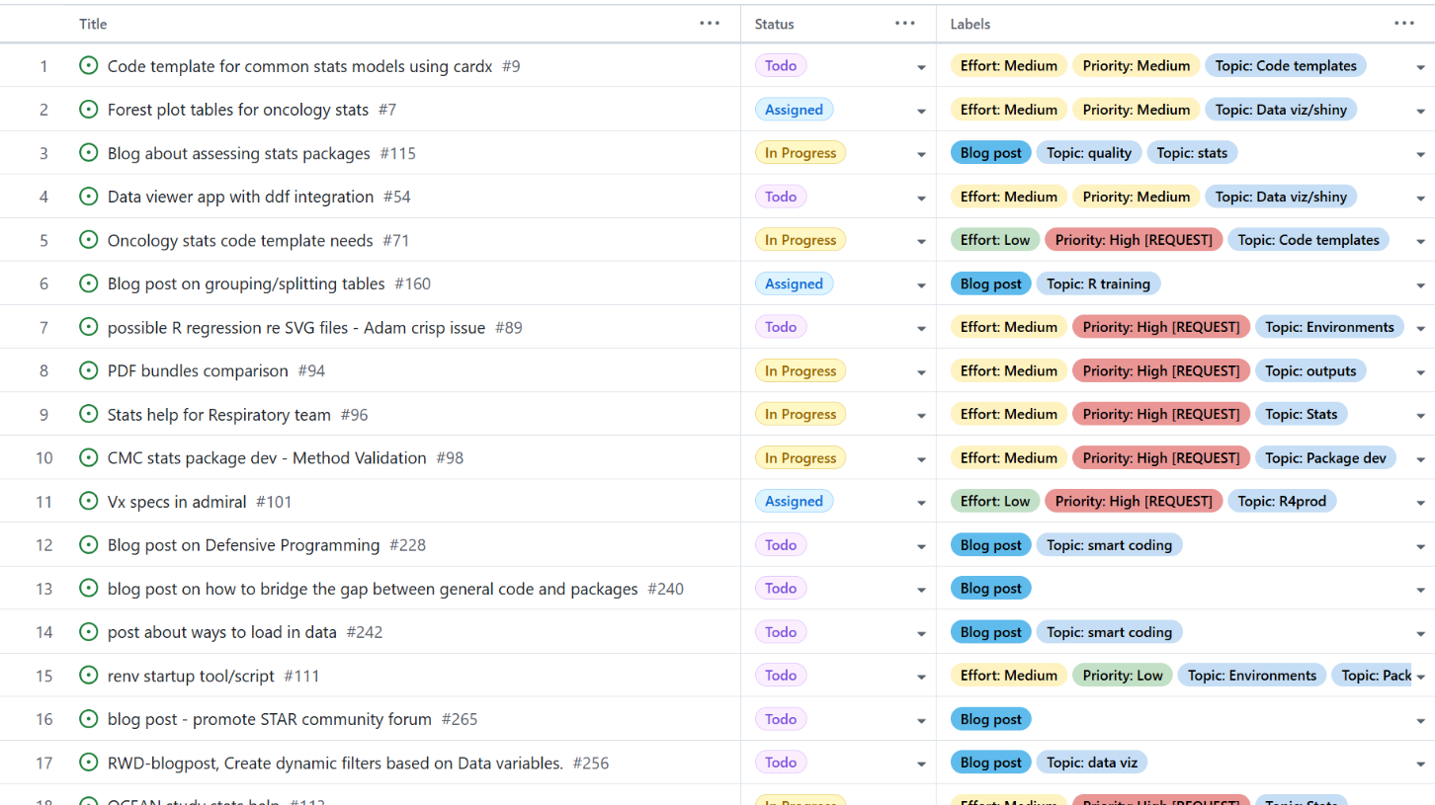
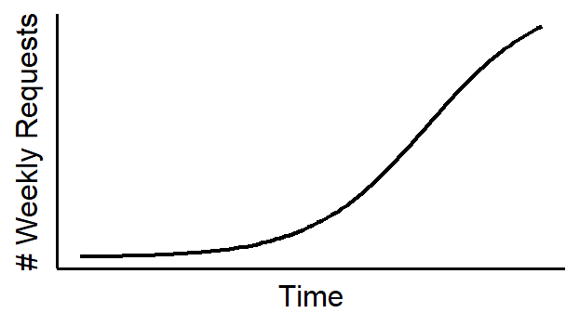
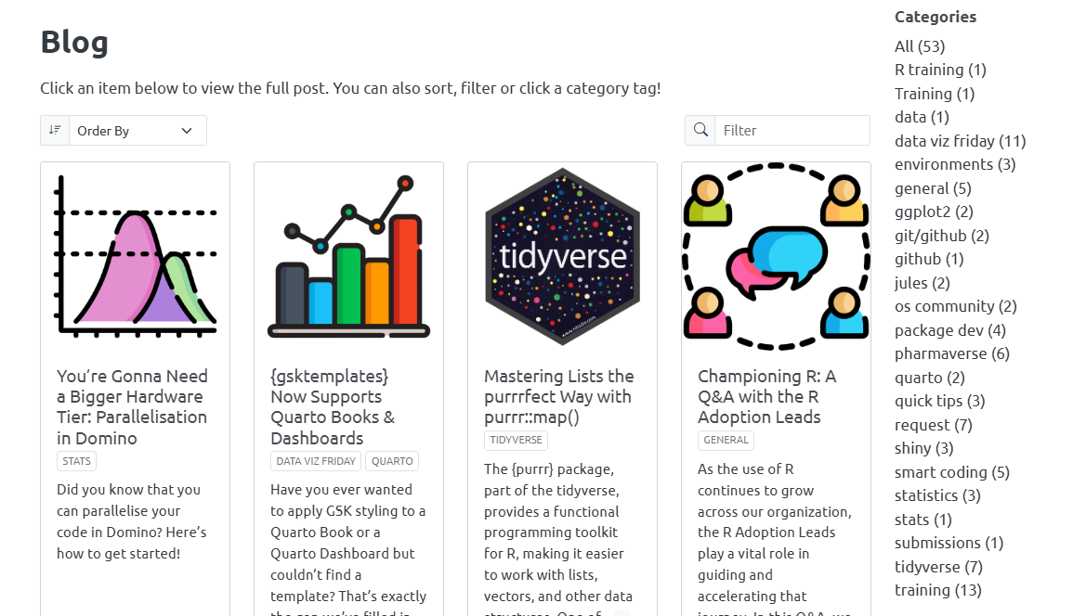
STARburst Impact
58 support requests
64 blog posts (posted daily)
Topics driven by the pipeline, featuring case studies and tricks/tips
821 unique viewers (~90% returning)
Notes:
1 req per day, but took time to build
We knew that do decided to blog
Blog because it’s quicker than formal docs which can get stuck in review as we try to make them perfect
Went well, +ve feedback.

Slide 20

Looking ahead…
Notes:
Finished May
Rolled back blog to more ad-hoc to focus on documentation
Documentation focussed on repeat requests to reduce these
Point people to docs more but not strictly saying ‘no’ yet

Slide 21

Conclusions
Image source: http://clustercrush.com/breaking-bottles-champagne-and-ship-christenings/
Notes:
That is actually a boat

Slide 22



Conclusions
Mass training will only get you so far
Focus on early adopters
Be prepared to change/adjust course
Listen to your users!
Notes:
As per slide

